Slide 1
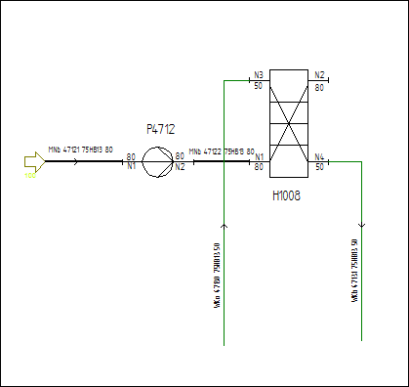
E12V01 – Heat Exchanger with Equipment Bar, Chambers, Nozzles
PlateAndShellHeatExchanger
4 Nozzles
2 Chambers
Chamber 1 connected to N3 and N4
Chamber 2 connected to N1 and N2
Engineering Data:
TagName H1201, including prefix, line number, suffix
Nozzles with nominal diameters (ISO 6708), including 3 representation strings
all data from equipment bar
H1201
Ident | H1201
Design Press. min. Chamber 1 / 2 | -1 barg | -1 barg
Design Press. max. Chamber 1 / 2 | 60 barg | 30 barg
Design Temp. min. Chamber 1 / 2 | -45 °C | -45 °C
Design Temp. max. Chamber 1 / 2 | 100 °C | 100 °C
Design Duty / Design Heat Transfer Area | 313 kW | 46,8 m²
Plate Height / Plate Width | 850 mm | 1100 mm

